Slide 1


Slide 2
Sudoku Visualizer Application
Subtitle: An Interactive Tool for Solving and Visualizing Sudoku Puzzles
Name: Kriti
Reg_No.:12217521
Date: 12/07/2024

Slide 3
Introduction
Overview:
Introduction to the Sudoku Visualizer application.
Purpose: Provide an interactive GUI for solving and visualizing Sudoku puzzles.
Key Features:
Random Sudoku puzzle generation.
Real-time input validation.
Visualization of the solving process.
Hint provision.
Puzzle reset and adjustable solving speed.

Slide 4
Features
Core Features:
Random Puzzle Generation: Generates Sudoku puzzles using a backtracking algorithm.
Solver: Visualizes the solving process step-by-step with an adjustable delay.
Hints: Provides valid numbers for empty cells.
Real-time Input Validation: Highlights valid and invalid inputs.
Reset Functionality: Resets the puzzle to its initial state.
Control Buttons: Solve, hint, reset, stop, and exit buttons.

Slide 5
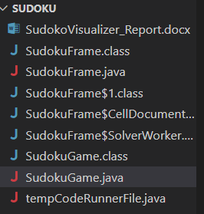
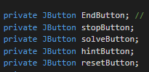
Technical Details
Class Structure:
SudokuFrame: Main class extending JFrame, handles GUI and user interactions.
SolverWorker: Nested class extending SwingWorker, responsible for solving the puzzle in the background.
SudokuGame: Class for starting the game with start button.
Key Methods:
validateInput(int row, int col): Validates user input and changes cell color.
generateRandomSudoku(): Generates a random Sudoku puzzle.
solveWithVisualization(int[][] board): Solves the puzzle with visualization.
resetBoard(): Resets the board to its initial state.
GUI Components:
JTextField[][] cells: Sudoku grid cells.
JButton solveButton, hintButton, resetButton, EndButton, stopButton: Control buttons.
JSlider speedSlider: Adjusts solving speed.

Slide 6
User Experience
Interactive Features:
User-friendly input with real-time feedback.
Visualization of solving process for better understanding.
Adjustable solving speed for user control.
Initial puzzle generation.
Real-time input validation (red for invalid, yellow for valid).
Solving visualization.
Hint functionality.

Slide 7
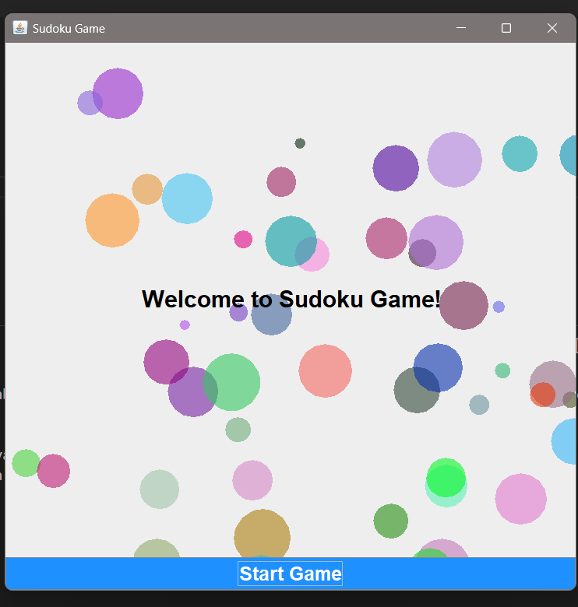

Slide 8
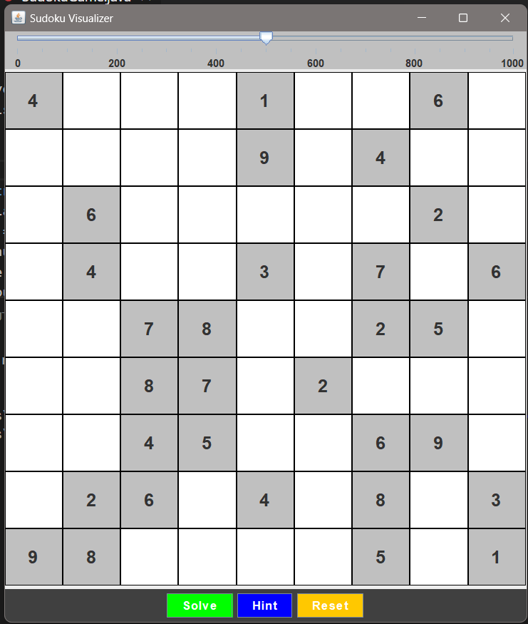

Slide 9
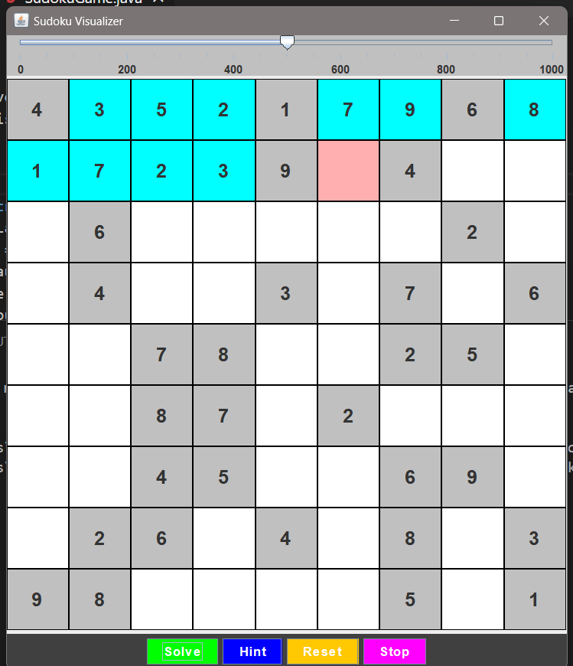

Slide 10
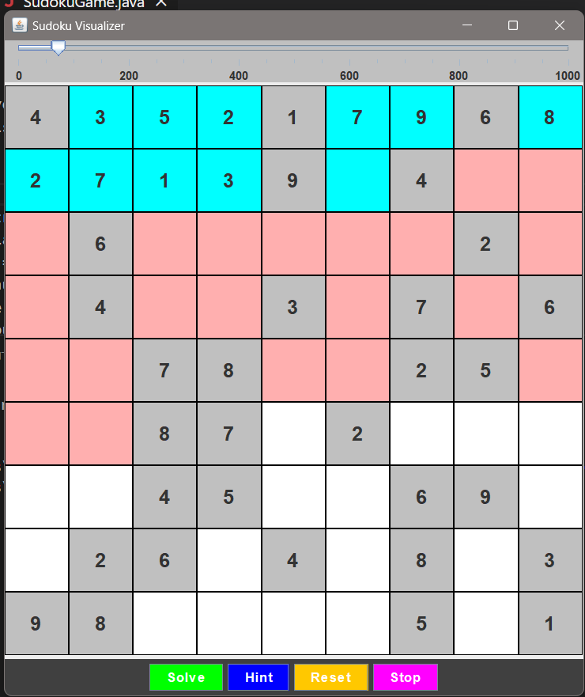

Slide 11
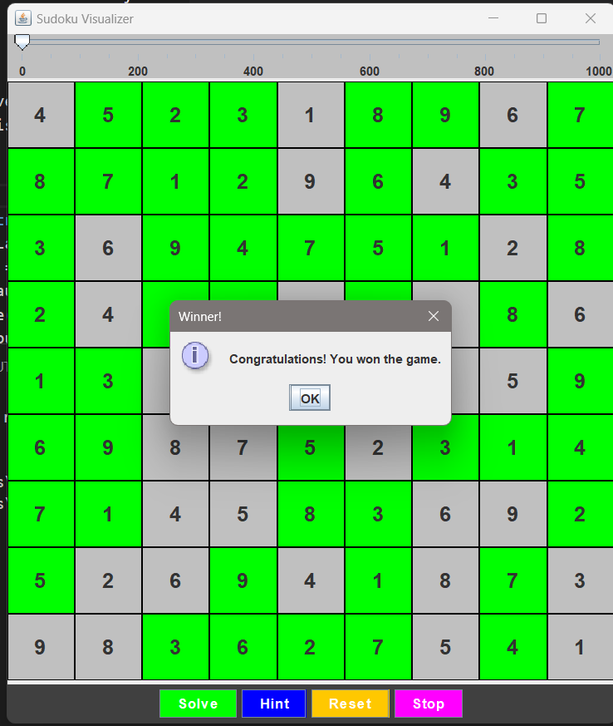

Slide 12
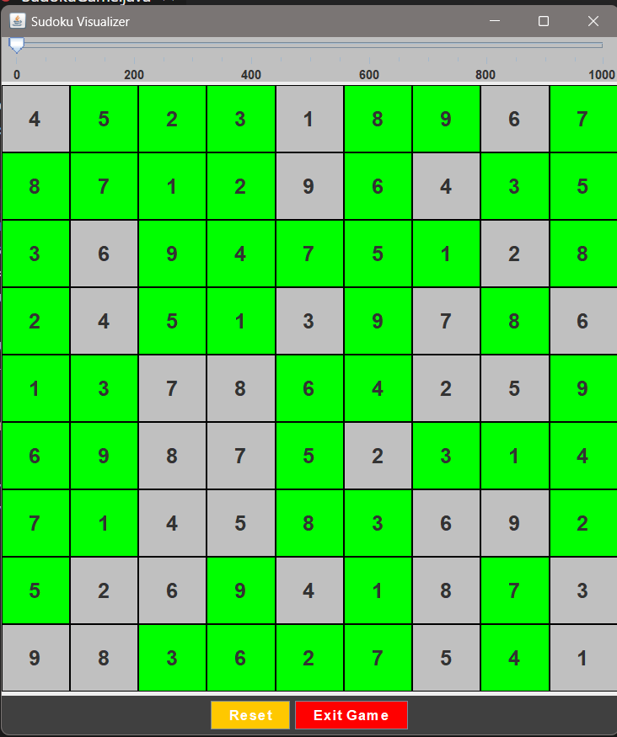

Slide 13
Conclusion
The Sudoku Visualizer is a powerful tool for solving and visualizing Sudoku puzzles.
Its interactive features and real-time feedback make it engaging for users. Future enhancements can further improve functionality and user experience.
The application serves as a great foundation for exploring advanced Sudoku solving techniques and visualization methods.

Slide 14
Thank You

